Slide 1
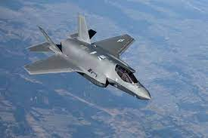


A Paper Review
BoGyu Choi
2024. 05. 13
TURBO PROPULSION LAB.

Slide 2
Contents
Introduction
Infrared extinction of a discrete particle
IR suppression characteristics of aerosol clusters
Aerosol particles dispersion characteristics
Challenges and suggestions

Slide 3
1. Introduction

Slide 4
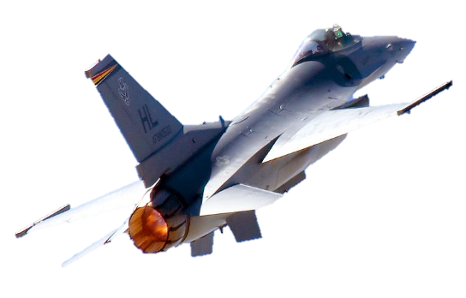
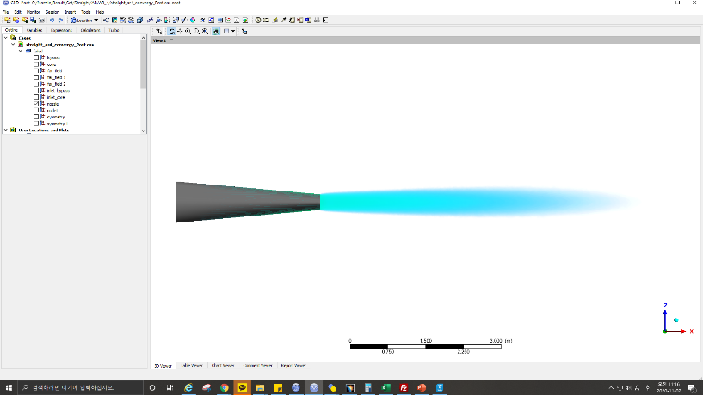
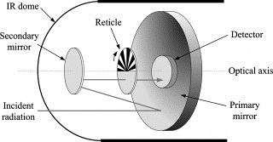
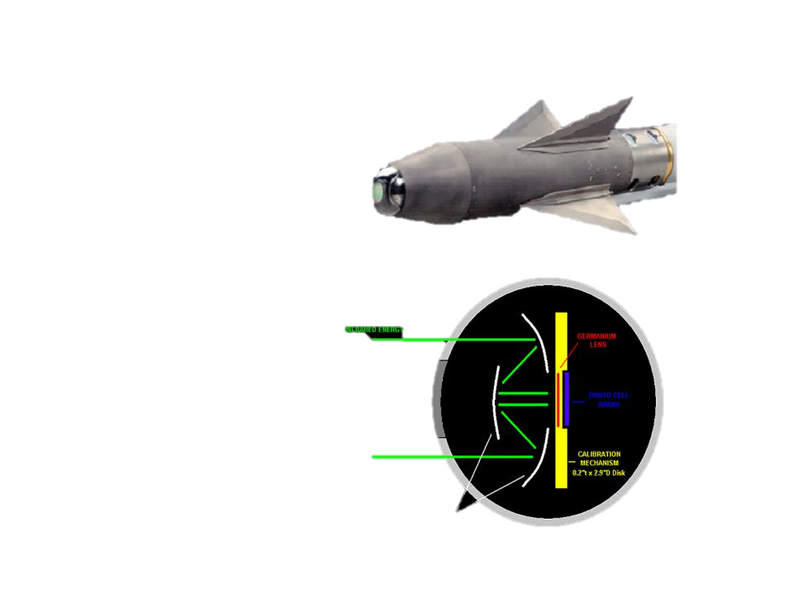
1. Introduction
- On the modern battlefield, stealth technology is a key element for aircraft survival.
- The survivability of the aircrafts is seriously threatened by the infrared (IR) thermal radiation emitted from the aircraft engine exhaust system.
- 70 % ~ 80 % damaged aircrafts were destroyed by IR guided missiles in recent local wars.
IR dome
IR energy
Reticle
Secondary mirror
IR energy
Detector
Incident radiation
Optical axis
Primary mirror

Slide 5
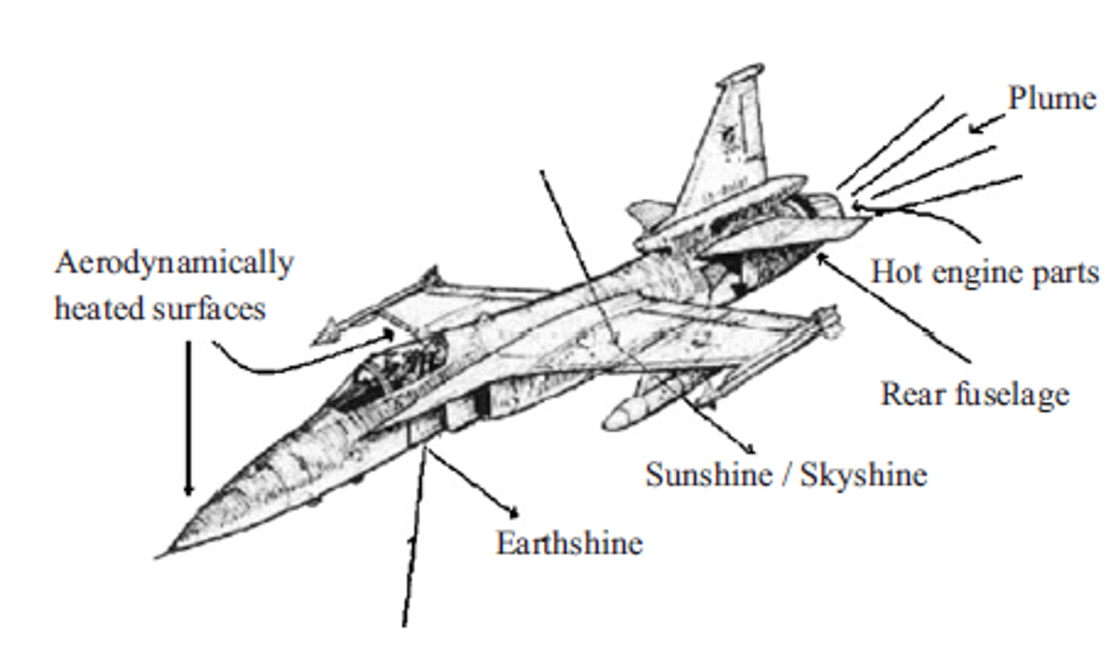
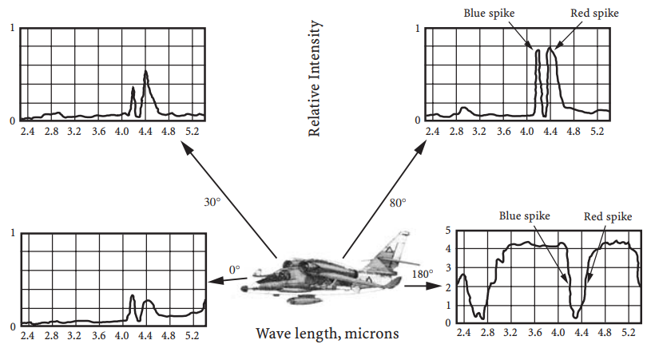
1. Introduction
The IR thermal radiation is mainly composed of two parts
The thermal radiation from the exhaust system of aero-engine
- The high-temperature cavity of exhaust nozzle
- The thermal exhaust plume
2. The aircraft skin
- The thermal radiation of the skin itself
- The input radiation of the skin reflecting
<Infrared signals emitted from aircraft>
=> The rear of the aircraft
IR signal from the propulsion system is measured the strongest.
IR guided missiles mainly detect and pursue such 3-5 μm signals.
IR radiation
in 3–5 μm : aero-engine exhaust system
in 8-14 μm : aircraft skin

Slide 6
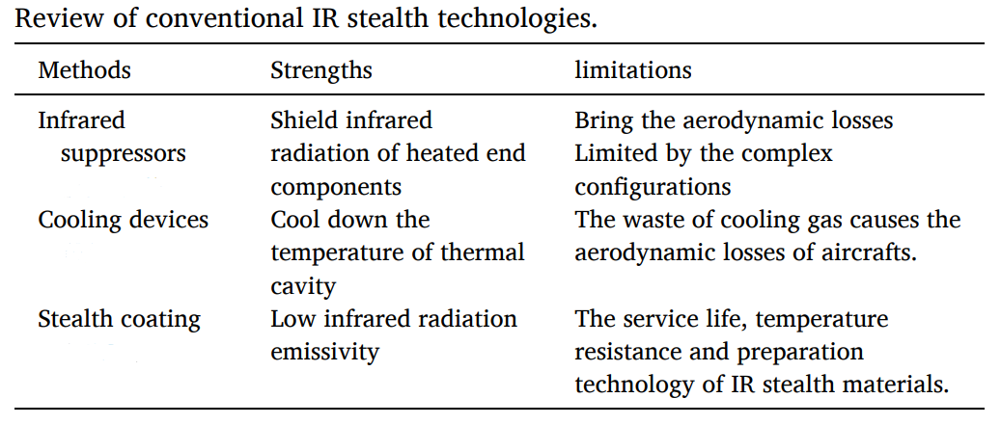
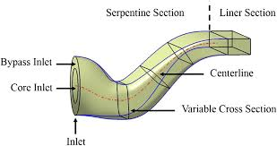
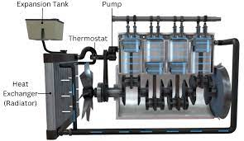
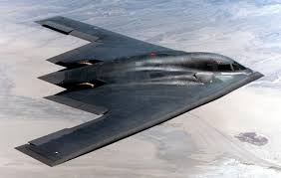
1. Introduction
The conventional IR stealth methods
infrared suppressors (IRSs)
cooling configurations of aero-engines
aircraft skin materials to reduce the IR signature
Another & New methods
IR signal reduction techniques
is needed.
IRSs : Serpentine nozzles
Exhaust cooling system
Stealth coating
AIRST : Aerosol infrared stealth technology

Slide 7
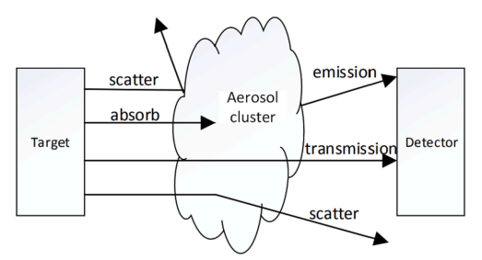
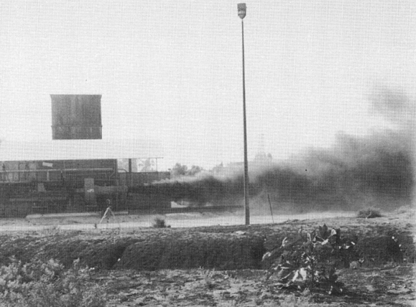
1. Introduction
AIRST : Aerosol infrared stealth technology
The basic principle of aerosol IR stealth technology is to take advantages of the IR absorption and scattering characteristics of aerosol particles to greatly reduce the IR radiation of aircraft engine exhaust system through the aerosol clusters.
It is a highly effective method to suppress the strong (IR) signal and interfere in the IR detection within a short time.
An active emergency IR stealth method that rapidly sprays powder particles around the targets to form an aerosol cloud in Fig.A
The basic principle : Disperse tiny particles
(Fig.A) Aerosol infrared stealth technology applied in ground engine experiments
Limitations of AIRST
There still exists no application in aircrafts in practice less thrust loss of aero-engines
can be negatively influenced by the aerosol particle dispersion and lengthened exhaust plume in flight conditions.
Advantages of AIRST
not changing the aerodynamic characteristics
less thrust loss of aero-engines

Slide 8
2. Infrared extinction of a discrete particle

Slide 9
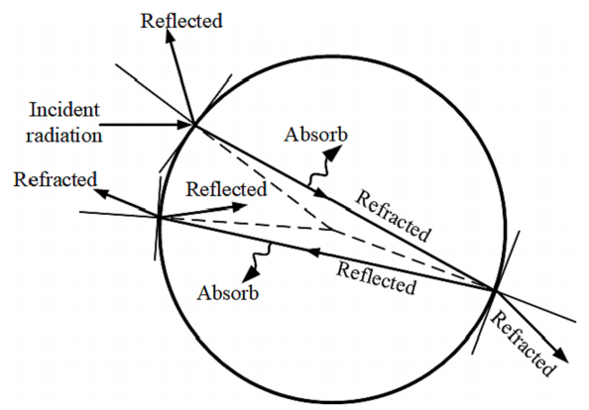
2. Infrared extinction of a discrete particle
Disperse tiny Particles
- 0.001 µm-100 µm
The mixed medium composed of exhaust gas and aerosol particles
- The IR radiation emitted by aerosol itself reduces the radiation deviation of the target from the background.
has a strong absorption and scattering effect
<Schematic of incident radiation scattered by a discrete particle>
On a discrete particle
part of the incident radiation -> reflected off the surface
part of the absorbed energy -> converted into other forms of energy
part of the refractive radiation -> such as heat, will go through a one-way propagation or multiple internal reflection inside the particle.

Slide 10
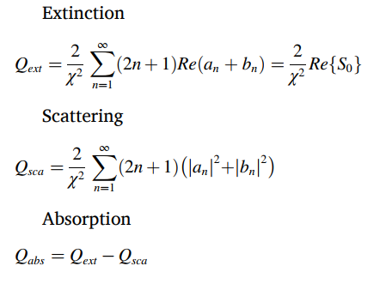
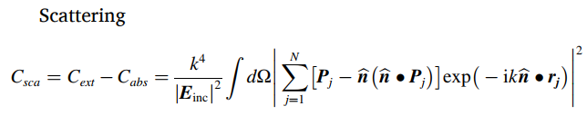
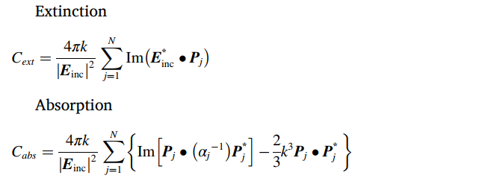
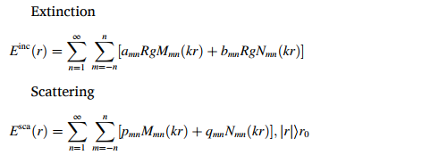
2. Infrared extinction of a discrete particle
Theory of radiation scattering
Mie-Debye scattering theory
The solution to the macroscopic Maxwell’s equations
For the far-field electromagnetic field.
It is only suitable for the radiation scattering for a homogeneous,
isotropic and spherical particle.
2. Discrete dipole approximation method (DDA)
an approximate solution of the volume integral equation
of electromagnetic scattering.
It can be used to study the scattering characteristics
of non-spherical, non-uniform and anisotropic particles.
3. T-matrix method
To use the expansion coefficient of the vector spherical
harmonic function.
It is appropriate for the calculation of extinction parameters
of non-spherical particles.

Slide 11
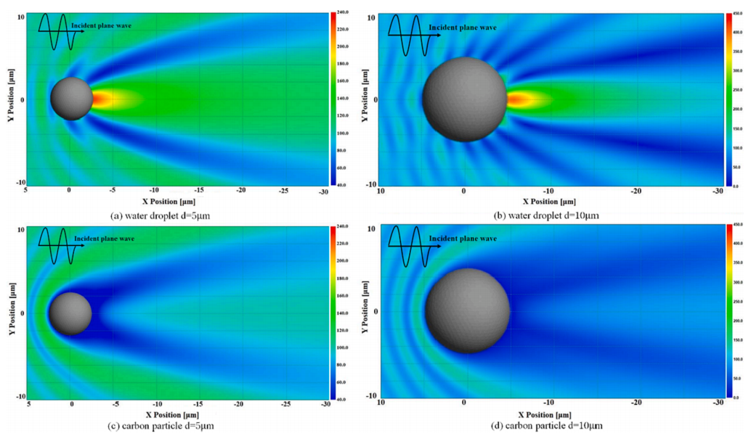
2. Infrared extinction of a discrete particle
IR extinction characteristics
Important about Optical characteristic
-> such as absorption cross section, scattering cross section, extinction cross section, asymmetry factor
Important basis of the anti-IR aerosol clusters.
Example
Size 5 μm VS 10 μm
: The larger the particle size, the greater the IR suppression effect in electric field
Water droplet VS Carbon particle
: The water droplet presents a forward scattering up to several times the incident wave, whereas the carbon particle has a weak electric field due to the high loss tangent
“ Particle size is not unconditionally important.”

Slide 12
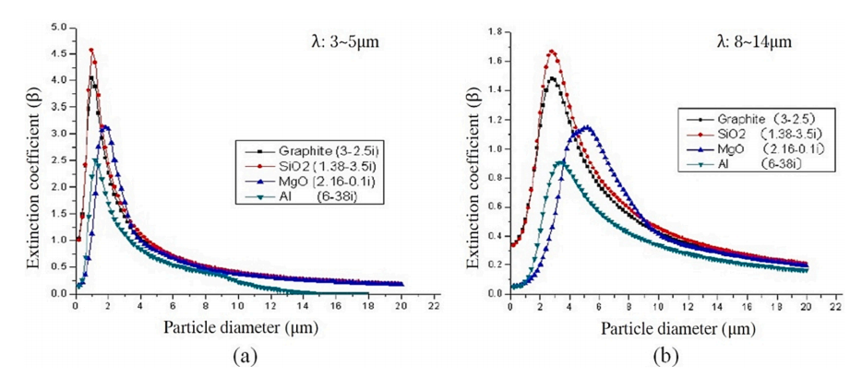
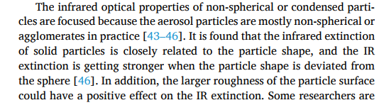




2. Infrared extinction of a discrete particle
This Fig provides the calculated variation curves of IR extinction coefficient along particle size at a certain complex refractive index and a fixed infrared band
“ It shows that there exists an optimum particle size for different materials to achieve the best IR extinction effect.”
How about particle shape?
“The less spherical the particle shape, the greater the IR extinction effect.”
“ The larger roughness of the particle surface
could have a positive effect on the IR extinction.”

Slide 13
3. IR suppression characteristics of aerosol clusters

Slide 14
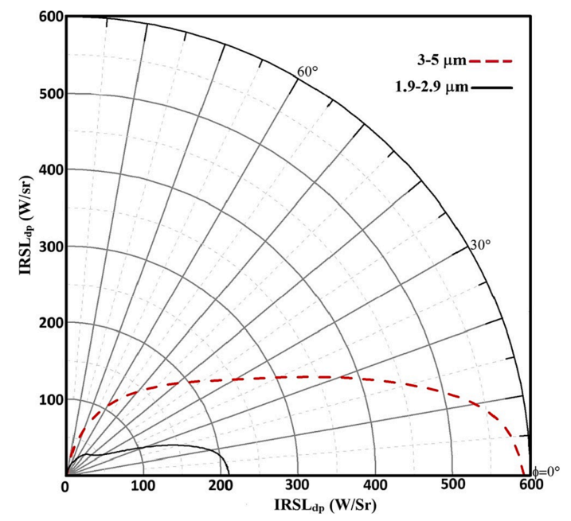
3. IR suppression characteristics of aerosol clusters
* Case 1 : Single round nozzle
Only considering the internal thermal sources with a turbine-exit temperature of 832 K.
- This Fig shows the polar plot of Infrared signature level (IRSL) from the rear portion of a classic converging nozzle in the1.9–2.9 μm and 3–5 μm bands.
* Infrared signature level (IRSL)
: The extent to which objects appear on infrared sensors
The IR signature remains a high value to the angle of 10◦
The IR radiation of aircraft exhaust system comes from
: exhaust nozzle walls and exhaust plume
- Radiation intensity of Exhaust nozzle walls
: it takes more than 90 % proportion

Slide 15
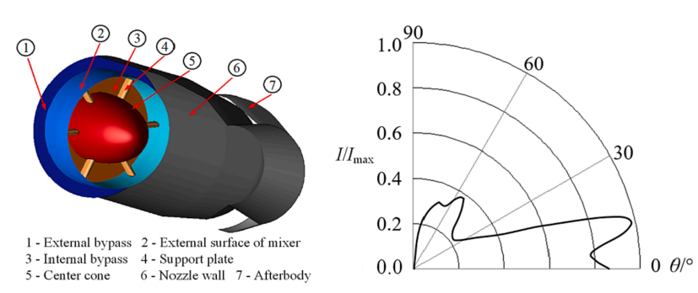
3. IR suppression characteristics of aerosol clusters
* Case 2 : Axisymmetric convergent-divergent nozzle with double bypasses
15◦
the maximum value around the angle of 15◦.
The intensity presents a violent fluctuation in the interval of 15◦ to 60◦
It follows that the aircraft are more easily detected
in the backward direction because of the higher IR signals.

Slide 16
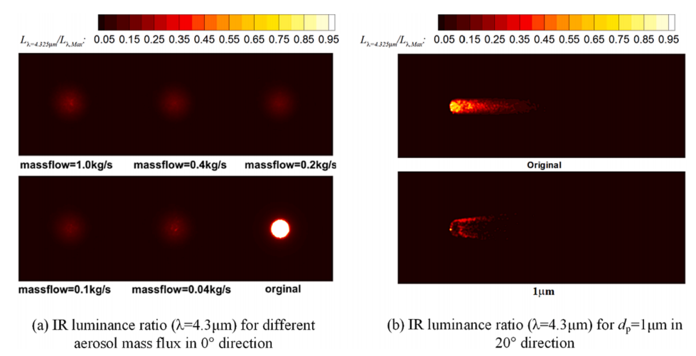
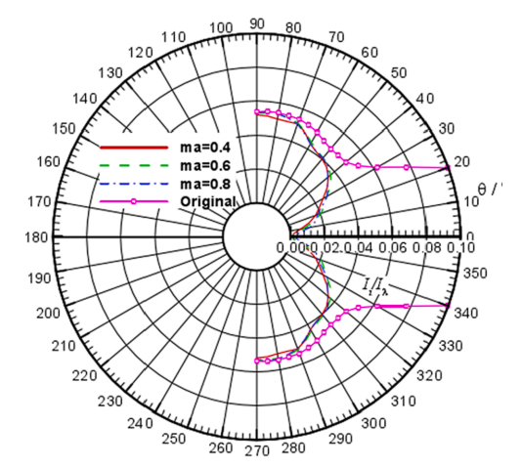
3. IR suppression characteristics of aerosol clusters
Research about Gao et al
- focused on the IR suppression effect of aerosol particles on the axisymmetric convergent-divergent nozzle with double bypasses
IR radiation intensity variation in horizontal plane when Ma < 1
Flight test
Ground test
=> It is very related to the dispersion characteristics of the particles.

Slide 17
4. Aerosol particles dispersion characteristics

Slide 18
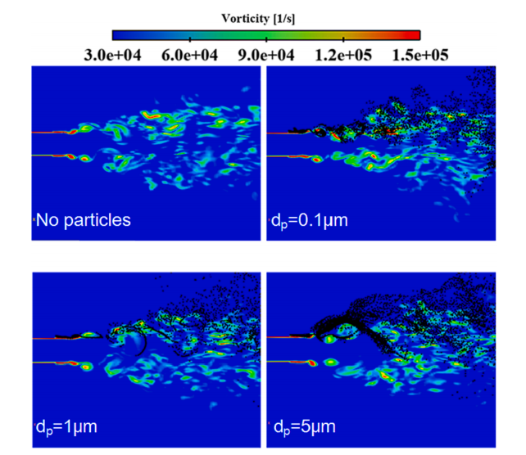
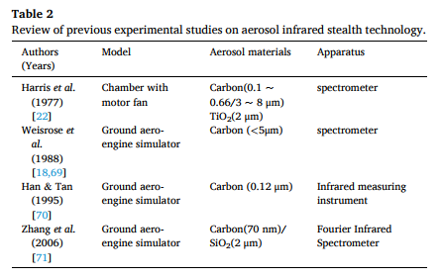
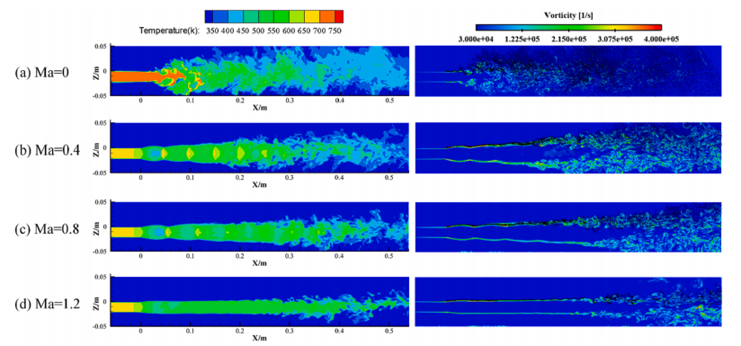
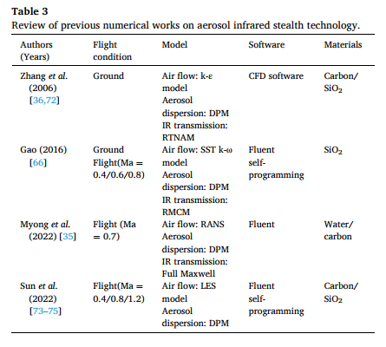
4. Aerosol particles dispersion characteristics
Important elements of particle dispersion
should be dense enough to suppress the IR radiation signals
uniform enough to form a reasonable aerosol layer
the particles should be avoided being enrolled in the high-temperature core of thermal jet
related to the particle size,
mass flux ratio,
aerosol injecting velocity,
aerosol injecting angle,
Modulation particles distribution
Etc…..
Notes:
위에서 논의한 바와 같이, 학자들은 배기가스 기둥에 있는 에어로졸 입자의 분포 패턴이 실제 IR 복사 억제에 큰 영향을 미친다고 믿습니다.
혼합 매체의 에어로졸 입자 농도는 IR 복사 신호를 억제할 수 있을 만큼 밀도가 높아야 하며 전체 열 제트를 포괄하는 적절한 에어로졸 층을 형성할 수 있을 만큼 균일해야 합니다.

Slide 19
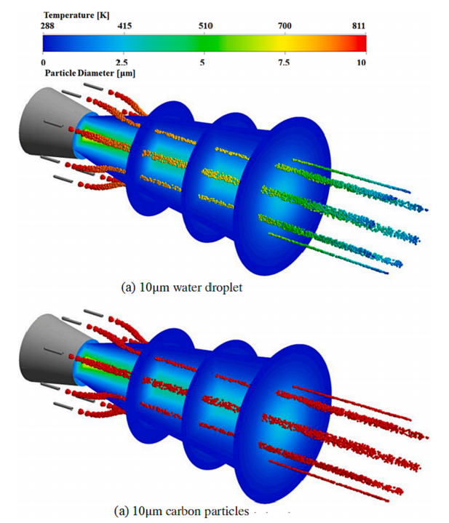
4. Aerosol particles dispersion characteristics
The aerosol particle distribution is closely related to the particle size, mass flux ratio, aerosol injecting velocity and aerosol injecting angle.
the sprayed water droplets and carbon powders would be entrained in the core region of hot exhaust plume
Water : The size of water droplets decreases. Because water evaporation.
Carbon : The particle size remains the same, but the temperature rises due to the chemical reaction.
“ The properties of the material must be taken into consideration.”
Notes:
그외에도 추가적으로 중요한 특성은 다음과 같다.

Slide 20
5. Challenges and suggestions

Slide 21
5. Challenges and suggestions
AIRST : Aerosol infrared stealth technology
1. The constraints on the aerodynamic performance.
2. A weak IR suppression effect when in supersonic flight speed.
3. The design of aerosol injecting device, including the size,
shape and number of aerosol nozzle, the arrangement of aerosol
nozzles
4. Inherent differences of two main infrared wavelengths
(3–5 μm and 8–14 μm), and the effective stealth aerosol materials
and size

Slide 22
Thank you!

